Slide 1
Infrared spectroscopy of planetological molecules
Isabelle Kleiner
Laboratoire Interuniversitaire des Systèmes
Atmosphériques (LISA), Créteil, France

Slide 2
Summary
Planetary observations
Strategy and methods
Molecular systems:
NH₃, PH₃, CH₃CN, ¹³CH₃D

Slide 3
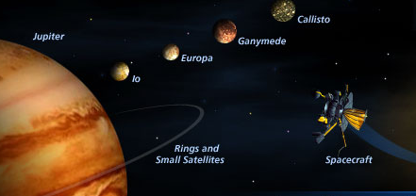
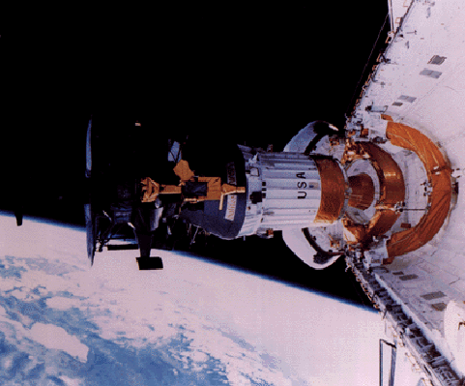
-Orbiting Spacecraft :
GALILEO: observations of Venus (1990) : ν₃ CO₂ 4.3 μm
mission to Jupiter (1996), Probe : first in-situ observations !
NIMS : Near Infrared Mapping Spectrometer
Grating spectrometer, 0.7-5.2 μm
R = 0.0125 μm < 1 μm ; 0.025 μm > 1 μm
GOOD
SPATIAL
RESOLUTION

Slide 4
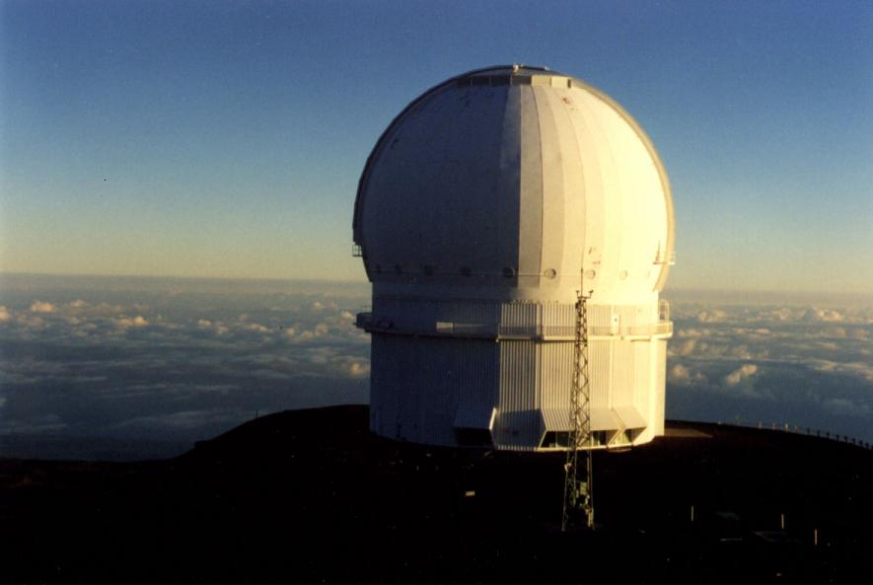
Planetary observations
-Ground based observatories:
Canada-France-Hawaii Telescope (CFHT)
Notes:
Venus: CO₂ 96%, N2 4%, H20, CO, SO2. P=90 bar, T= 740K, clouds. Thermic profile determined thanks CO2 → wind structure

Slide 5
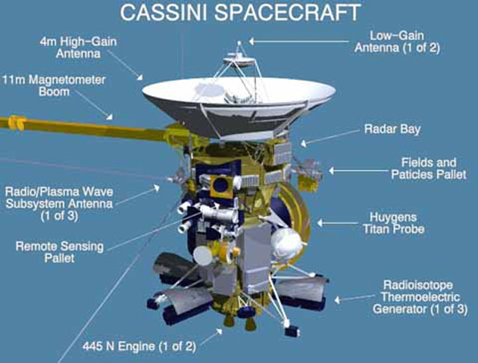
Cassini/Huygens
Study of Saturnian system, launched 1997
Flew past Jupiter on december 2000
Go into orbit of saturn in july 2004
ESA entry probe Huygens in Titan atmosphere 14/01/2005
-Visible and Infrared Mapping Spectrometer (VIMS)
0.35-1.07 μm; visible
0.85-5.1 μm; IR
-Composite Infrared Spectrometer (CIRS)
10-1400 cm⁻¹
Interferometers, Resolution 0.5 cm⁻¹

Slide 6
WHAT DO WE NEED FOR ANALYZING
PLANETARY SPECTRA?
Basic transition line parameters:
● Line position (or center frequency)
● Line intensity at 296 K
● Lower state energy (for temperature dependence)
● Vibrational - rotational quantum assignment
Line shape parameters (Voigt)
self-broadening coefficients, pressure brodening, line mixing…
Notes:
H2 broadened CH₄ Tran and hartman DP16
R. Gamache talk

Slide 7
How to model the IR spectra of
NH₃ ,PH₃ , C₃H₈ in the gas phase?
STRATEGY USED
First step : obtain experimental data for both line positions and line intensities of pure ¹⁴NH₃ , PH₃ , … in the lab.
2) Analyze the data using an appropriate theoretical approach :
taking into account : - inversion motion of NH₃ ,
- different interactions between energy levels for NH₃ and PH₃.
⇒ “ best ” energy and intensity parameters obtained
⇒ complete line-by-line prediction with all information needed.

Slide 8
NH₃ and PH₃: Giant Planets
-Largest planetary bodies in solar system (99.56% of the planetary mass)
« Gas giants »: H₂ and He :
Jupiter
Saturn
« ice giants » : ices of water and CH₄ :
Uranus
Neptune
Mean temperatures at 1 bar :
Jupiter: 167 K; Saturn: 138 K (Uranus:79K,Neptune : 70K)

Slide 9
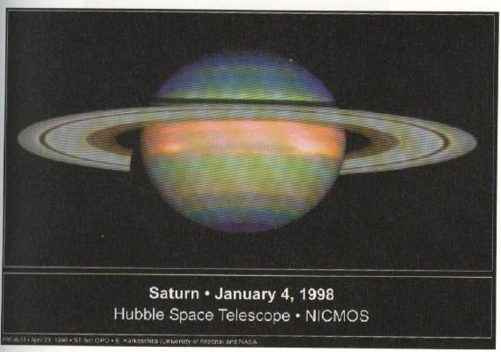
3 microns spectral range: Saturn and Jupiter have very different spectra
NH₃ ice cloud
PH₃ :
NEED
FOR
SPECTROSCOPIC
DATA !

Slide 10
Phosphine is a molecule of astrophysical and astronomical interest and has been observed in both the Jupiter and Saturn atmospheres
Between 800-300 K:
4PH₃ + 6H₂O P₄O₆ +12H₂
At the cold temperatures of
upper troposphere should
not be detectable
BUT vertical mixing transports
PH₃ faster than oxidation.
PH₃ abundance gives
information on vertical circulation
PH₃ : A non-equilibrium species
Notes:
Spectre de Saturne observé à l’aide du spectromètre par transformée de Fourier du télescope
CHFT (Canadian Hawaii France Telescope) en 1987 avec une résolution de 0.2 cm-1 Un spectre
synthétique est superposé qui utilise les données spectroscopiques de Tarrago et al. (TAR92). Le meilleur
ajustement entre le spectre calculé et le spectre observé est obtenu pour un rapport de mélange PH3/H2 de
4.5 10-6

Slide 11

Development of the theoretical model and programs for fitting the IR spectra of C_{3v} molecules
 | 2ν₂ | ν₂+ν₄ l₄ | 2ν₄ l₄ | ν₁ | ν₃ l₃
2ν₂ | K-type interaction Diag | Coriolis | Coriolis Fermi | Fermi | Coriolis
ν₂+ν₄ |  | l- type interaction Diag | Coriolis Fermi | Coriolis | Fermi
2ν₄₂ |  |  | l- type interaction Diag | Coriolis Fermi | Coriolis Fermi
ν₁ |  |  |  | K-type Interaction Diag | Coriolis
ν₃ |  |  |  |  | l- type interaction Diag

Slide 12
Recent works on PH₃
- A computed room temperature line list for phosphine, Clara Sousa-Silva, Sergei N. Yurchenko, Jonathan Tennyson, J. Mol. Spectrosc. 288 (2013) using the TROVE program
Spectroscopic parameters of phosphine, PH3, in its ground vibrational state, Holger S.P. Muller, JQSRT, 130, 335 (2013)
Global calculations using potential functions and effective Hamiltonian models for vibration-rotation spectroscopy, V.Tuyterev, M. Rey, in preparation
Line Positions and Intensities of the Phosphine (PH3) Pentad near 4.5 microns
V. Malathy Devia, Isabelle Kleiner, Robert L. Sams, Linda R. Brown, D. Chris Benner, Leigh N. Fletcher, J. Mol. Spectrosc.,298, 11–23 (2014)
-Line shape parameters of PH3 transitions in the pentad near 4-5 micron; self-broadened widths, line mixing and speed dependence, V. M. Devi, D. C. Benner, I. Kleiner, R. L. Sams and L. N. Fletcher, J. Mol. Spectrosc. 302, 17–33 (2014)

Slide 13
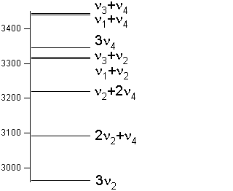
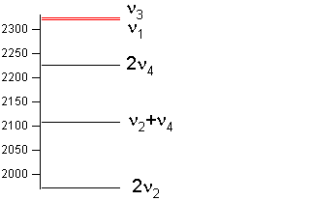

-The band 3ν₂:
Low resolution of line positions (Maki et al. JCP 1973)
- The octad bands:
New line positions and intensities measurements (Butler , Brown, Kleiner et al., JMS 2006)
The Global analysis of the Dyad, pentad and octad bands: (Nikitin, Brown, Kleiner et al., JMS 2009)
• The 2ν₂/ν₂+ν₄/2ν₄/ν₁/ν₃ pentad:
-Frequencies: rms=0.009 cm⁻¹ up to J=16
(Tarrago et al. JMS, 1992, Ulenikov and al. JMS, 2002)
Intensities: rms= 13% (Tarrago et al. JMS, 1992
NEW MEASUREMENTS NEEDED
•The ν₂/ν₄ dyad:
-Frequencies: rms=0.0004cm⁻¹ up to J=22
(Fusina and al, J.Mol.Struc.,2000 )
-Intensities: rms=2% (Brown, Kleiner and al., JMS, 2001)
-Linewidth: self Broadening coefficients
(J. Salem and al, JMS, 2004)

